Slide 1

EE 463 Hardware Project
2025-2026 Fall
DC Motor Drive with Three-Phase Rectifier and
Current-Mode Controlled Buck Converter
Group 6
Maide Esra Şirin- 2516979
Ece Canbaz- 2515724
Battal Emre Sevinç- 2516896
December 6, 2025

Slide 2
Outline
Problem Definition
Topology Selection
3-Phase Rectifier + Buck converter
Control Method
Component Selection
Simulation Results
PSIM
Ltspice

Slide 3
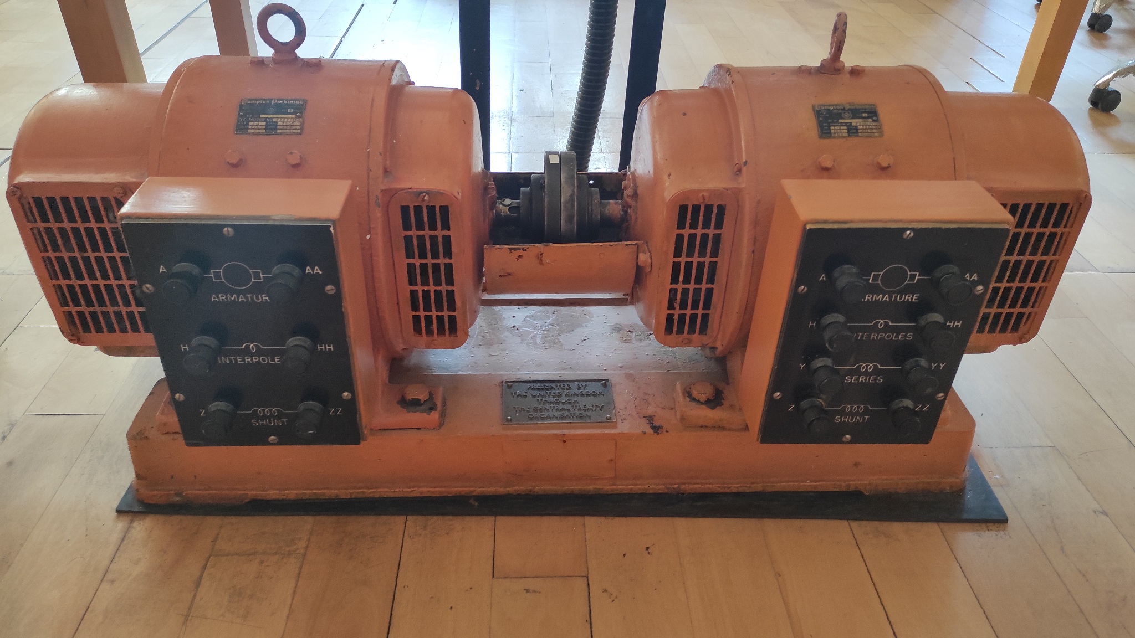
Problem Definition
AC / DC converter
Drive the motor from
standstill
Maximum 180V adjustable
output voltage
Current and voltage
protection

Slide 4
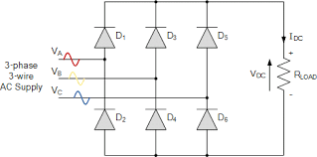
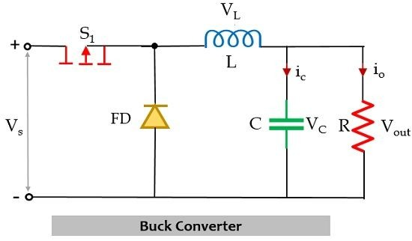
Topology Selection
3-phase rectifier + Buck Converter Topology
Notes:
Many designs exist, most simple one is 1 phase fbdr, but not for four quadrant
H bridge is one option
thyristor dual converter is second option
bu we have chosen h bridge with a chopper as the final choice, and to reduce the ripple we will use 3 phase fbdr

Slide 5
Topology Selection: Control Method
Why do we need closed loop control?
To keep the output voltage constant against load changes and input voltage fluctuations.
To obtain a more stable and reliable power supply.
To minimize deviations from the targeted output voltage value.
Notes:
Off the shelf half bridge gate drivers
Microcontroller - arduino
PWM duty will be adjusted for different mosfets for different modes
Closed loop PID current control will be implemented to reduce the ripple and avoid high currents and voltages
Duty change will be adjusted
Tuning will be done after the test setup is ready, possibly with potentiometers

Slide 6
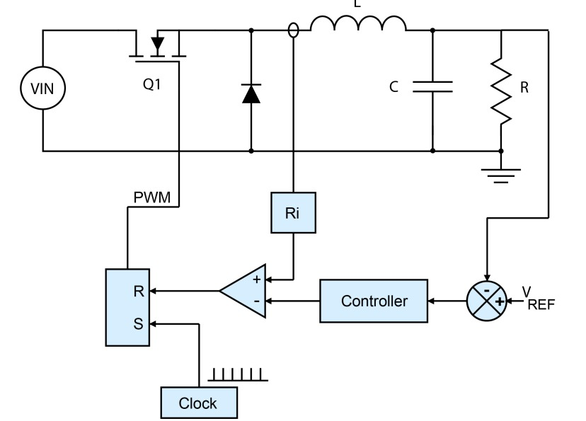
Topology Selection: Control Method
Peak Current Mode Control
Two control loops are used:
Inner Loop: Controls the inductor current.
Outer Loop: Controls the output voltage.
Advantage: Unlike Voltage Mode, it provides a more stable and faster response by directly controlling the inductor current.

Slide 7
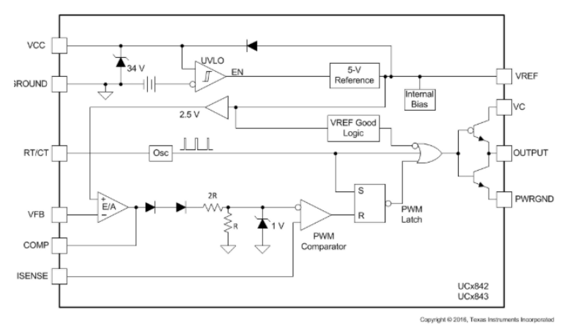
Component Selection
Our diode, MOSFET, rectifier and fuse selection is based on 560V and 30A. We selected devices that can handle this parameters.
Controller IC (UC3842)
Peak current mode control
Protection to high current
Fast response
Notes:
The advantages of pcb implementation

Slide 8
Component Selection: UC3842 Control System
Internal Operation of UC3842
Error Amplifier: Generates the peak current target by comparing the feedback voltage with the internal reference.
Current Sense Comparator: Turns off the switch cycle-by-cycle as soon as the sensed inductor current hits the target level.
PWM Latch and Oscillator: Initiates the switching cycle and resets the latch to turn off the switch when the current peak is detected.
Overall Closed Loop: The UC3842 regulates the plant (Buck Converter + DC Motor) by driving the MOSFET through the FOD3120 isolator based on feedback signals.
Notes:
All the internal power conversions will be handled
All

Slide 9
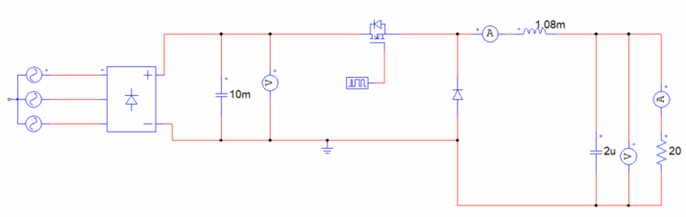
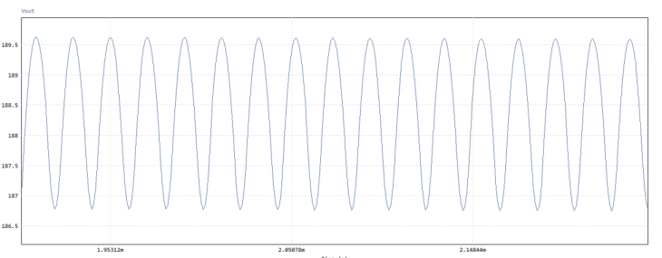
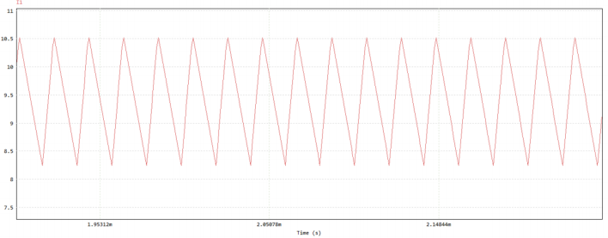
Simulation Results: PSIM - Open Loop Testing
We conducted ideal tests with
PSIM.
Open loop testing:
Output voltage and inductor
current:
Notes:
All the internal power conversions will be handled
All

Slide 10
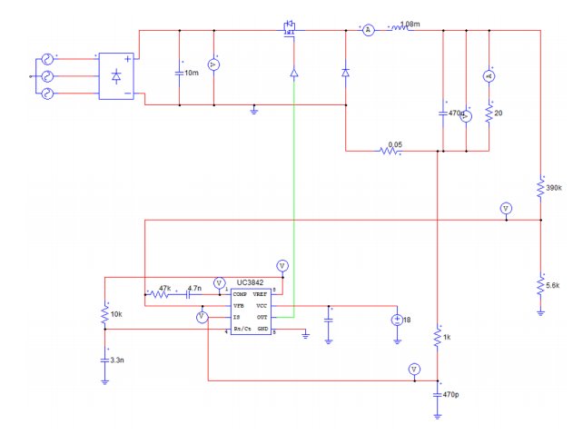
Simulation Results: PSIM - Closed Loop Testing
Notes:
All the internal power conversions will be handled
All

Slide 11
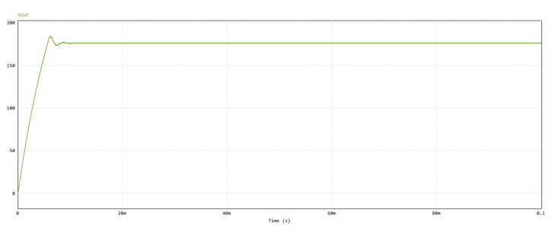
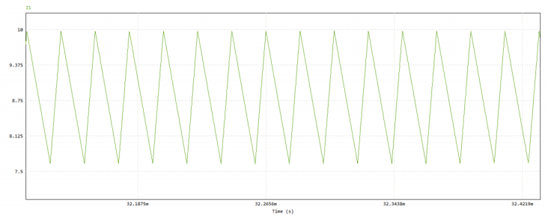
Simulation Results: PSIM - Closed Loop Testing
Output Voltage:
Inductor Current:
Notes:
All the internal power conversions will be handled
All

Slide 12
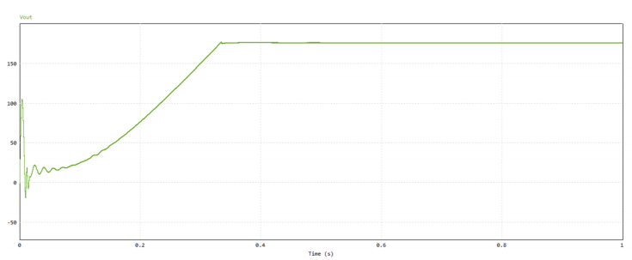
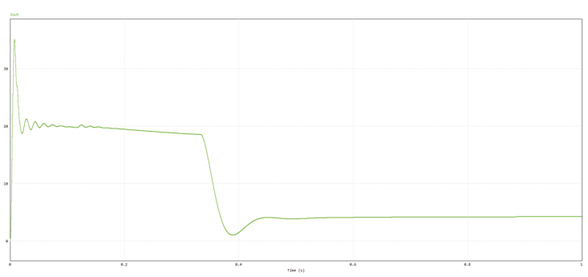
Simulation Results: PSIM - With DC Motor
Output Voltage:
Output Current:
Notes:
More complex simulations and calculations will be made
Heatsink and fan will be utilized

Slide 13
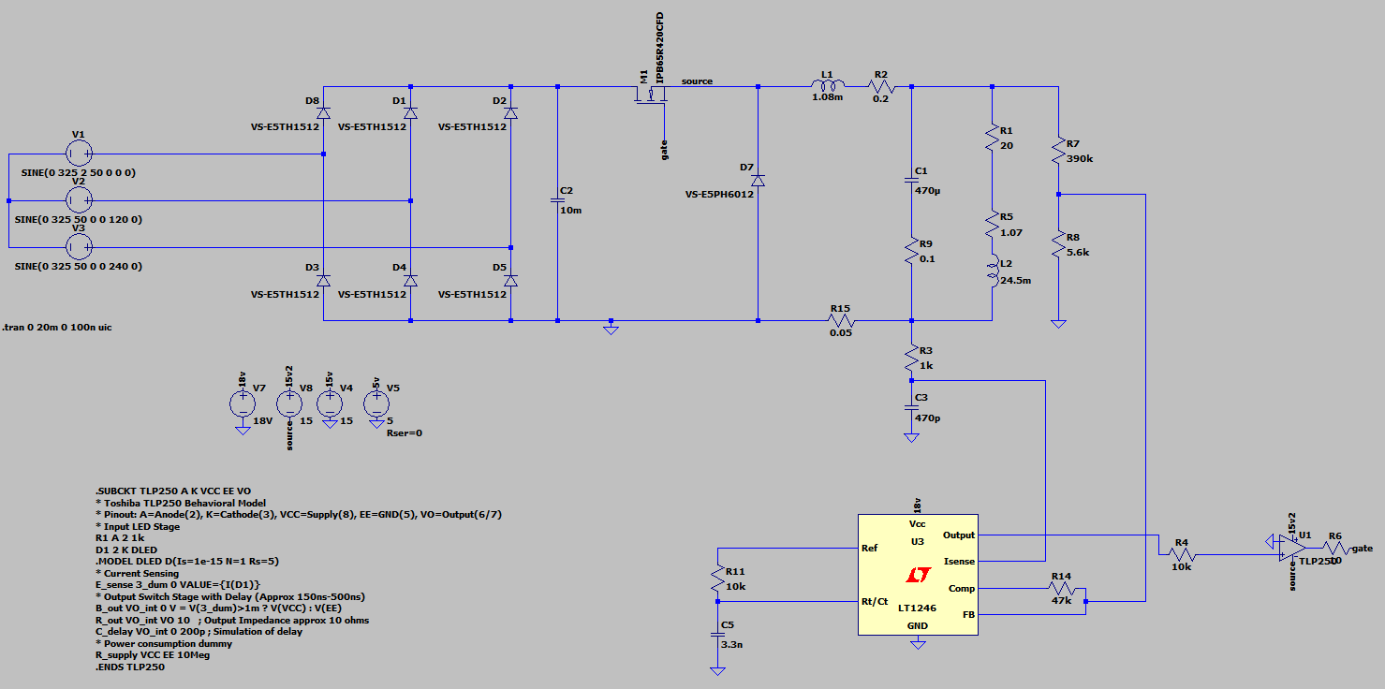
Simulation Results: Ltspice
Notes:
All the internal power conversions will be handled
All

Slide 14
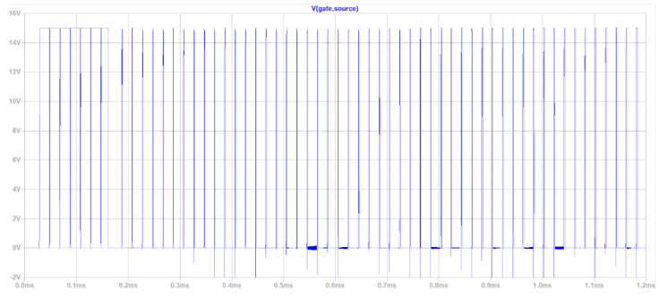
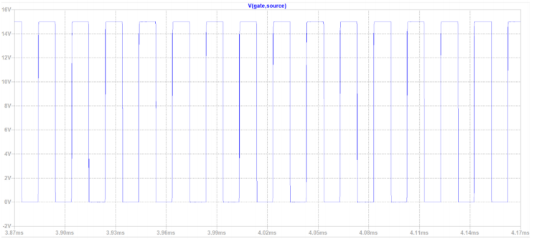
Simulation Results: Ltspice
Vgs voltage: Duty cycle is given from here
Initial Vgs Voltage:
Steady state Vgs Voltage:
Notes:
Rds on (hence conduction losses) is inversely proportional with the current rating, which brings a price tradeoff
Lower voltage ratings require more careful designs to avoid voltage spikes, good avalanche ratings, and careful control; possibly lots of gate opening losses to stay in the linear region more to avoid the spikes, which is a large trade-off and risk

Slide 15
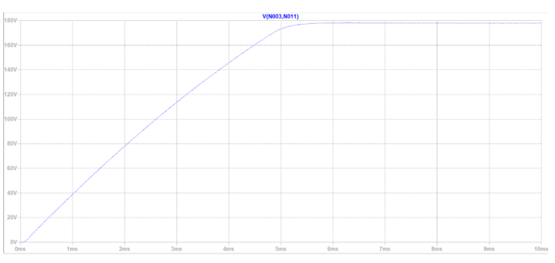
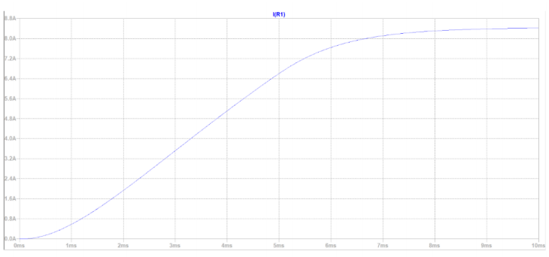
Simulation Results: Ltspice
Output Voltage:
Output Current:
Notes:
Here we can see the trade offs between the MOSFET choices

Slide 16
References
[1] https://electronicscoach.com/buck-converter.html
[2] https://www.electronics-tutorials.ws/power/three-phase-rectification.html
[3] https://www.ti.com/product/UC3842

Slide 17
Thank you for your attention.

